Slide 1




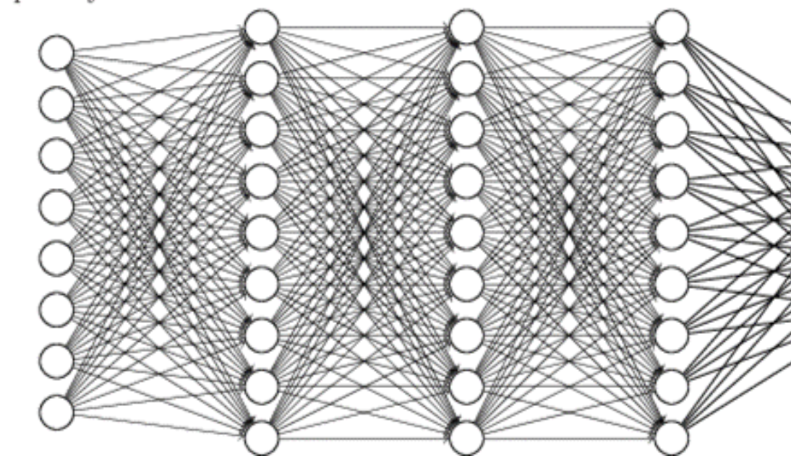
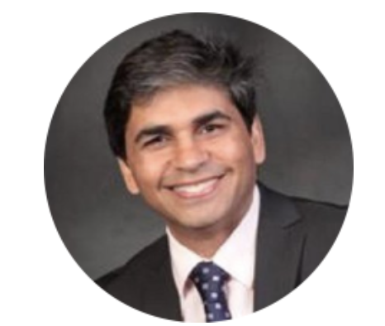
31 May 2018
Seminar
Artificial Intelligence:
application in life and health sciences
by
Tarry Singh
11.00-12.00 Victor Haderup Auditorium
(Blegdamsvej 3B 2200 København N, Denmark)
Target Audience: Entire Copenhagen university community with no prior coding experience
Goals: Acquire elementary Deep Learning skills, gain understanding of advanced techniques in machine learning
Tarry Singh@deepkapha.ai
17+ years Head of Data Science, Entrepreneur,
Mentor Deep Learning @Coursera, AI & Neuroscience Researcher
& Enthusiast + Analytics Executive, Blog: https://tarrysingh.com/
Contact:
Gopal Karemore, PhD
Image & Data Analysis Expert
Protein Imaging Platform
Novo Nordisk Center for Protein Research and Stem Cell Biology
gopal.karemore@cpr.ku.dk

